Slide 1



MODEL DEPLOYMENT
Loan Approval Predictions
Melissa Nielsen
December 9, 2022

Slide 2
PYTHON, POSTMAN, OR BASH
Make API POST request by passing JSON with data on which to predict
Receive predictions as JSON
DEPLOYED MODEL
Preprocessing
Predictions

Slide 3
MODEL CREATION
LOCAL DEPLOYMENT
CLOUD DEPLOYMENT
Pre-processing
Write deployment script in app.py file
pickle file
Feature Engineering
Launch using flask
Host in AWS instance
Model Training and Fit
Test deployment locally

Slide 4


HYPOTHESES
Applicants who are male are more likely to get loans
Applicants who are married applicants are more likely to get loans

Slide 5
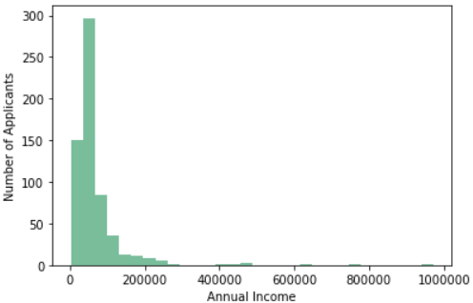
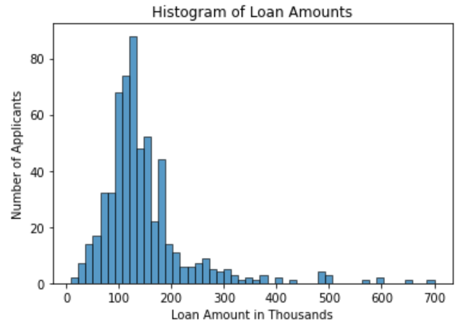
EXPLORATORY DATA ANALYSIS
01
02
INCOME
INCOME
Right-Tailed Distributions, mean != median
Outliers exist!

Slide 6
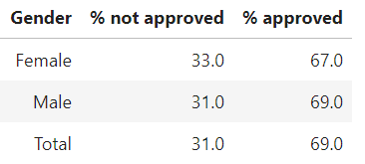
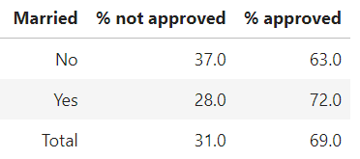
ORIGINAL HYPOTHESES
01
02
GENDER
MARITAL STAUS
Right-Tailed Distributions, mean != median
Outliers exist!

Slide 7
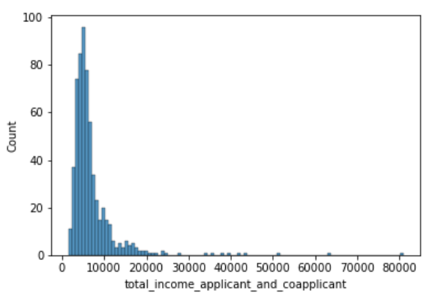
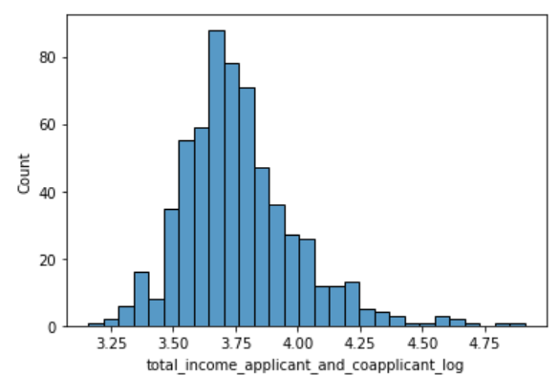
FEATURE ENGINEERING
Log Transform of Money Variables
BEFORE
AFTER

Slide 8
MODEL DESIGN
Model | R^2
Random Forest Classifier | 0.82
XGBoost | 0.81
Tried Random Forest Classifier and XGBoost

Slide 9
MODEL DESIGN
Parameter | Value Used
Criterion | gini
Max_depth | 4
Max_features | sqrt
N_estimators | 500
Used GridSearchCV to tune hyperparameters

Slide 10
PIPELINE
PREPROCESSING
MODEL
Transform categorical variables
Random Forest Regressor
Transform $$$ variables
Transform other numerical variables

Slide 11
MODEL CREATION
LOCAL DEPLOYMENT
CLOUD DEPLOYMENT
Pre-processing
Write deployment script in app.py file
Use tmux
pickle file
Feature Engineering
Launch using flask
Host in AWS instance
Model Training and Fit
Test deployment locally
COMING SOON…

Slide 12
API
The API is running!...
But not yet making predictions.

Slide 13
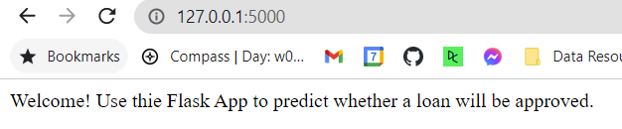

API
UNTIL THEN…

